Slide 1
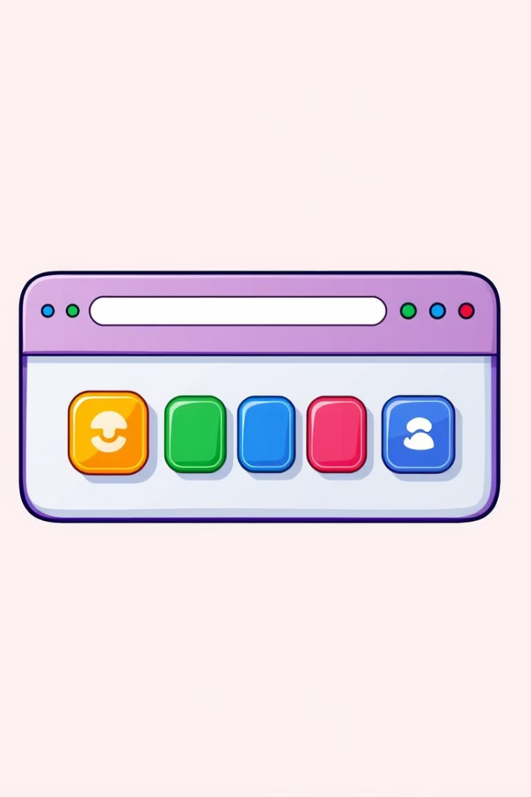
JavaScript Day 2 – Making Websites Interactive!
How JavaScript Talks to Your Webpage

Slide 2

What is the DOM?
Webpage as a House
DOM is the Blueprint
JavaScript: Magic Remote
Imagine your webpage as a house.
The DOM is the HTML structure.
Changes the house: adds rooms, paints walls.

Slide 3
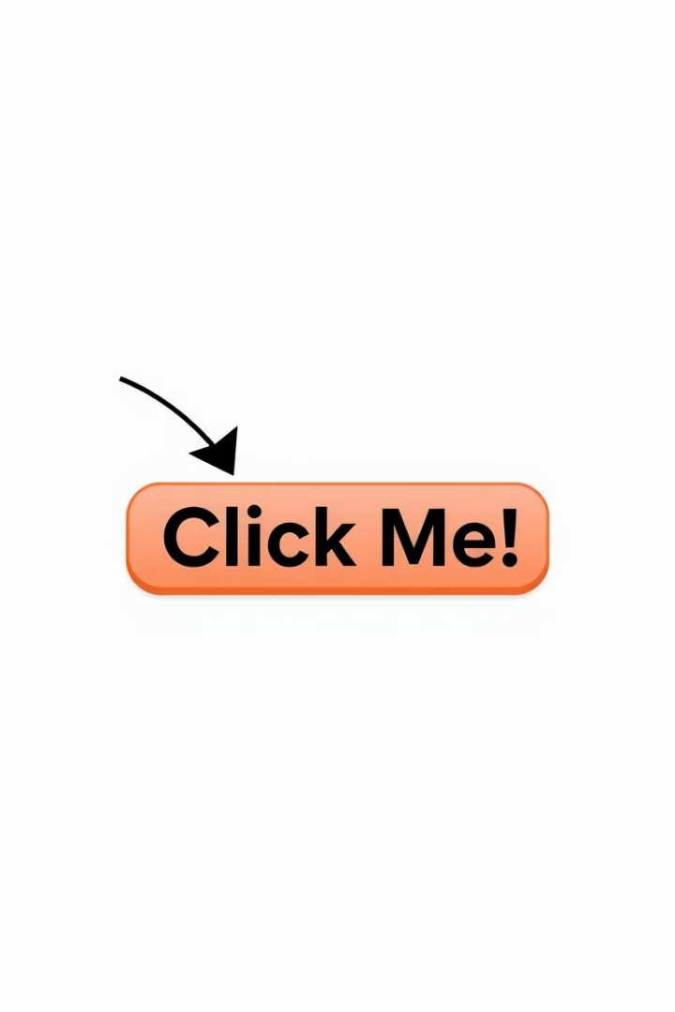


How to "Find" Things on a Webpage
Like a TV Remote
Code Example
Select a button before changing it.
document.querySelector("#lightSwitch");

Slide 4
Changing Things on the Page (DOM Manipulation)
Analogy
Change Text
Change Color
Changing a lightbulb’s color with a remote.
button.textContent = "Turn ON";
button.style.backgroundColor = "yellow";

Slide 5




Responding to Clicks (Event Listeners)
Press Doorbell
It rings!
JavaScript Listens
Listens for clicks.
Code Example
button.addEventListener("click", function() { alert("Ding Dong!"); });

Slide 6
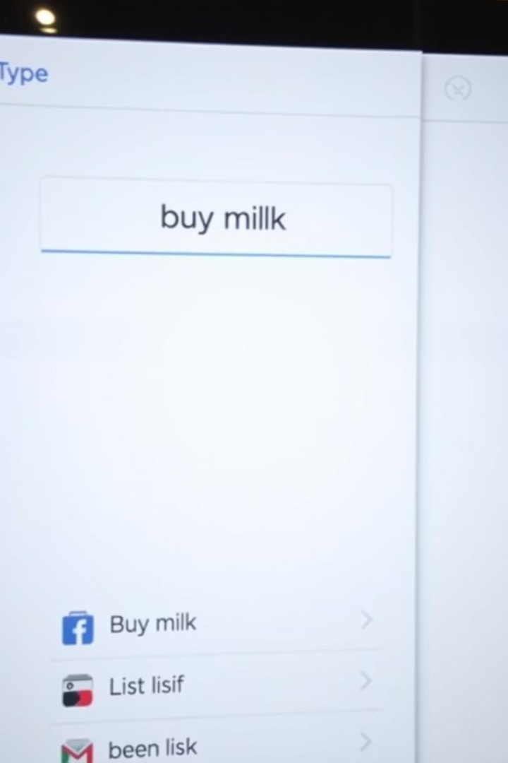
Real-World Example – Interactive To-Do List
HTML Structure
Text box + "Add" button.
JavaScript Logic
Add event listener to button.
Add Task
Get input value, add to list.

Slide 7

Common Mistakes (Debugging Tips)
Nothing Happened?
Wrong Color?
Check getElementById spelling.
Check for typos: backgroundColor.
Is JS file linked to HTML?

Slide 8

Key Takeaways
1
2
3
DOM is Key
Select Elements
Manipulate Content
Foundation for interaction.
Find what you need.
Change text, styles.
4
Event Listeners
Respond to user actions.

Slide 9

Next Steps: Advanced Interactions
1
Form Validation
Ensure correct user input.
2
Animations
Add dynamic visual effects.
3
AJAX
Load data without page refresh.

Slide 10



Thank You!
Questions?

